Slide 1
Nidhi Mehta THE SPARKS FOUNDATION
GRIP (Graduate Rotational Internship Program) JUNE 2021 BATCH DATA SCIENCE AND BUSINESS ANALYTICS
TASK 1 - PREDICT THE PERCENTAGE OF AN STUDENT BASED ON THE NUMBER OF STUDY HOURS, USING SUPERVISED ML

Slide 2
Sample Data
Hours | Scores | Hours | Scores
2.5 | 21 | 3.3 | 42
5.1 | 47 | 1.1 | 17
3.2 | 27 | 8.9 | 95
8.5 | 75 | 2.5 | 30
3.5 | 30 | 1.9 | 24
1.5 | 20 | 6.1 | 67
9.2 | 88 | 7.4 | 69
5.5 | 60 | 2.7 | 30
8.3 | 81 | 4.8 | 54
2.7 | 25 | 3.8 | 35
7.7 | 85 | 6.9 | 76
5.9 | 62 | 7.8 | 86
4.5 | 41

Slide 3
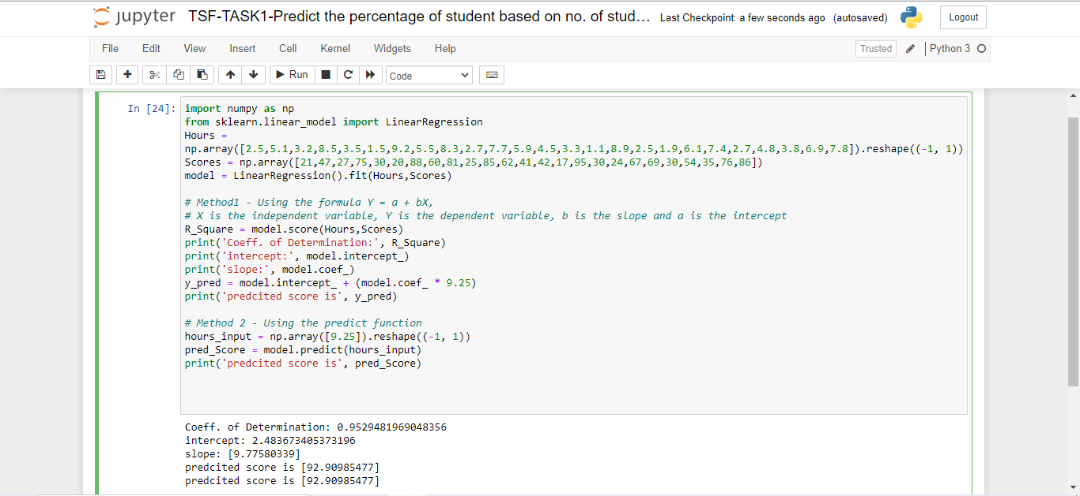
Solution

